Slide 1
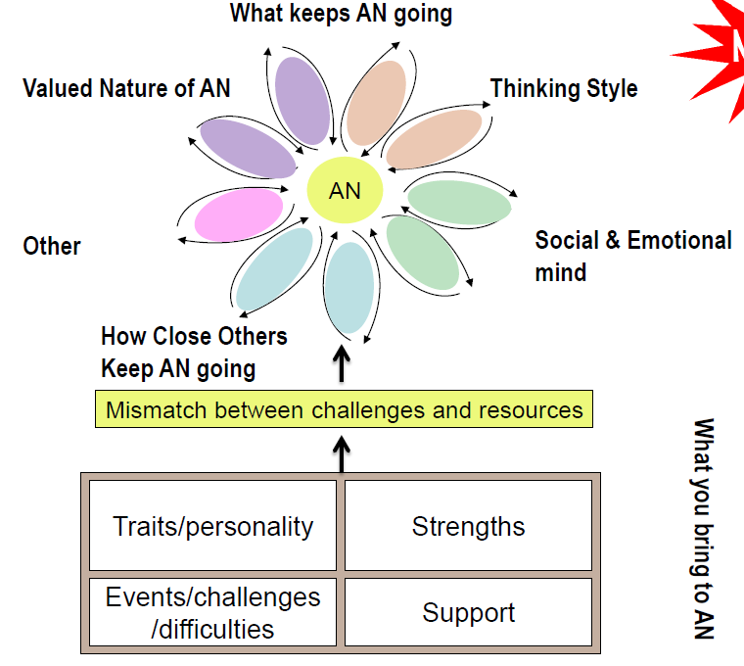
Overview MANTRA formulation

Slide 2
MANTRA
What you bring to AN
Traits/personality
Strengths
Events/challenges/difficulties
Supports

Slide 3
MANTRA
What keep AN going: Valued nature of AN
AN mode
Free text
Free text
Free text

Slide 4
MANTRA
What keep AN going: Thinking style
AN mode
Free text
Free text
Free text

Slide 5
MANTRA
What keep AN going: Social & Emotional Mind
AN mode
Free text
Free text
Free text

Slide 6
MANTRA
What keep AN going: How close others keep AN going
AN mode
Free text
Free text
Free text

Slide 7
MANTRA
What keep AN going: Free text
AN mode
Free text
Free text
Free text

